Slide 1


Sharing and promoting you and your work
Ginny Barbour
Director, Australasian Open Access Strategy Group (AOASG)
Advisor, Office of Research Ethics and Integrity and Library, Queensland University of Technology, Brisbane
Sandra Fry Project Officer, AOASG
@openaccess_anz
www.aoasg.org.au

Slide 2
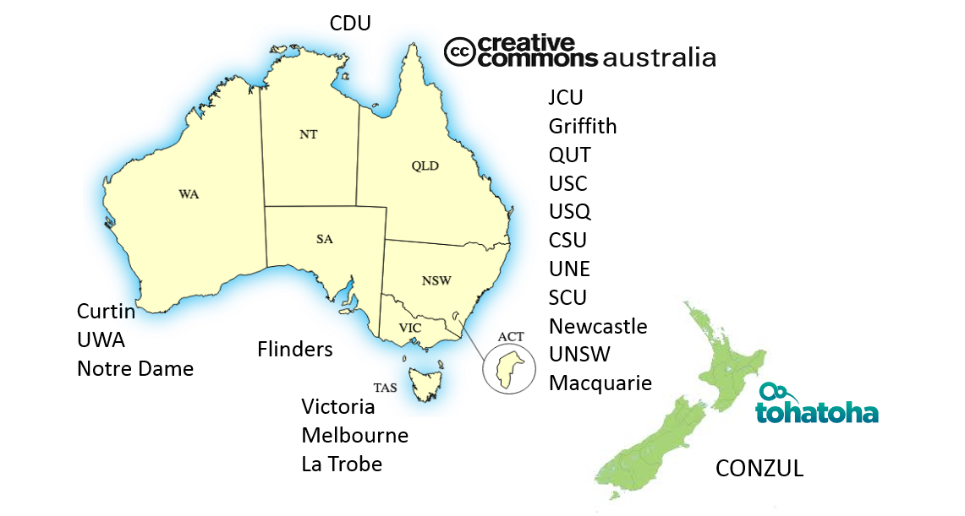
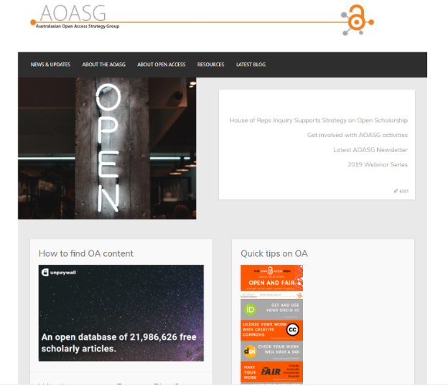
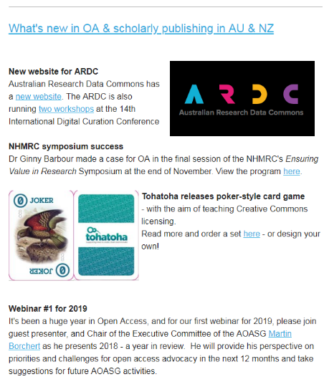
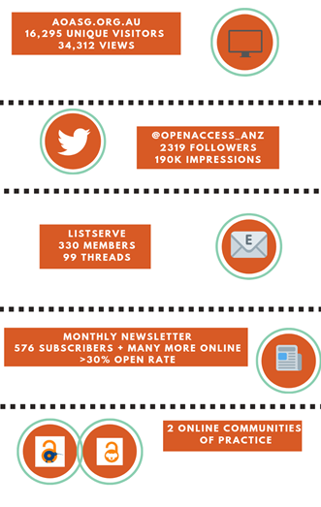
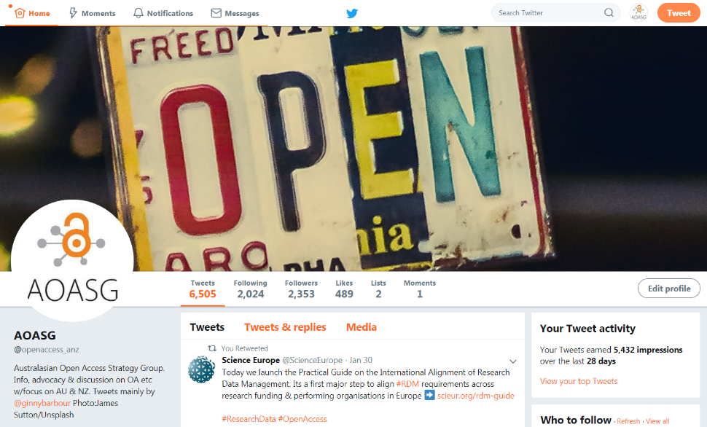
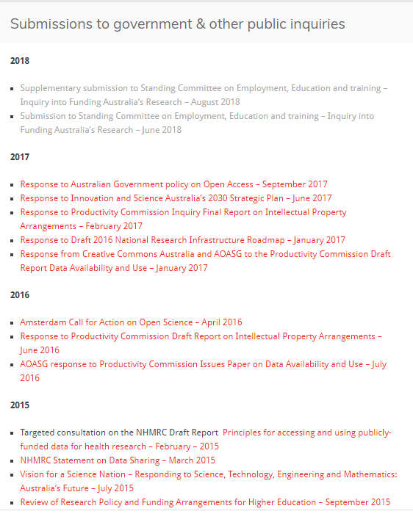
AOASG – what we do Advocate to make Australasian research open & FAIR
Notes:
Nineteen universities in Australia and CONZUL in NZ
CC Australia an d Tohatoha are members

Slide 3

An interconnected, equitable, accountable, global scholarly ecosystem of well-curated, interoperable research articles, data and software supported by a diverse infrastructure of open publishing models.
Think bigger: open scholarship

Slide 4

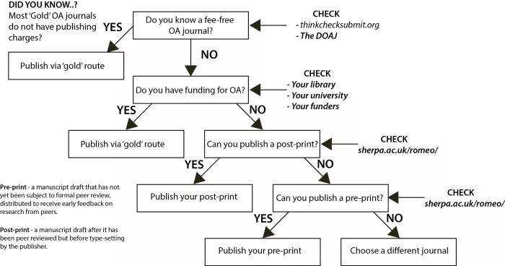

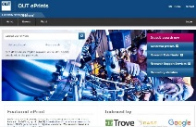


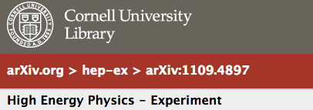

The most efficient way to share your work?
- publish openly
http://fossilsandshit.com/got-oa/

Slide 5
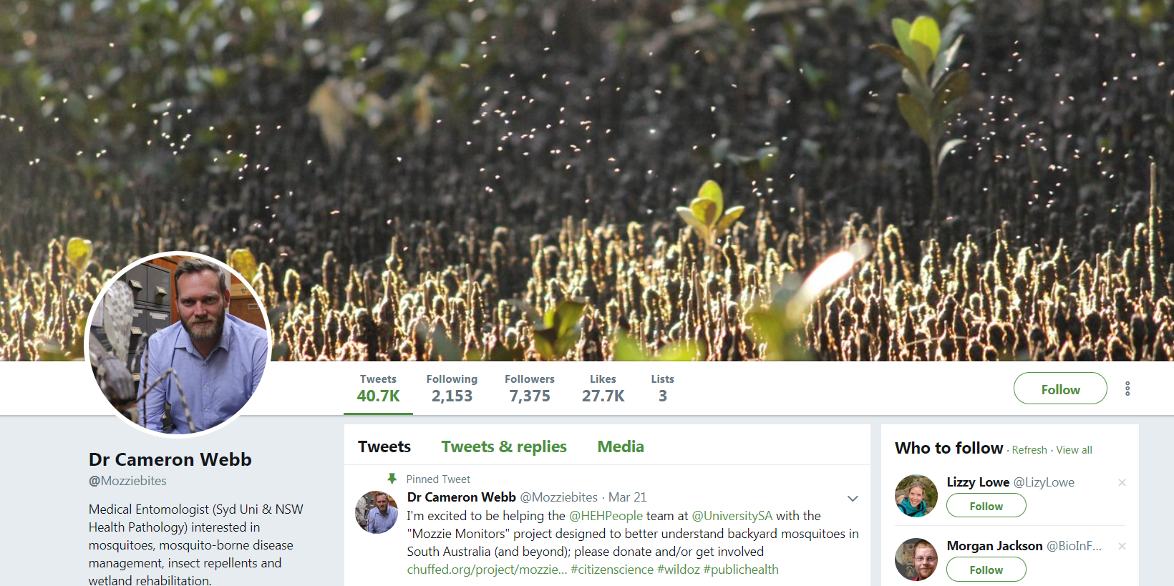
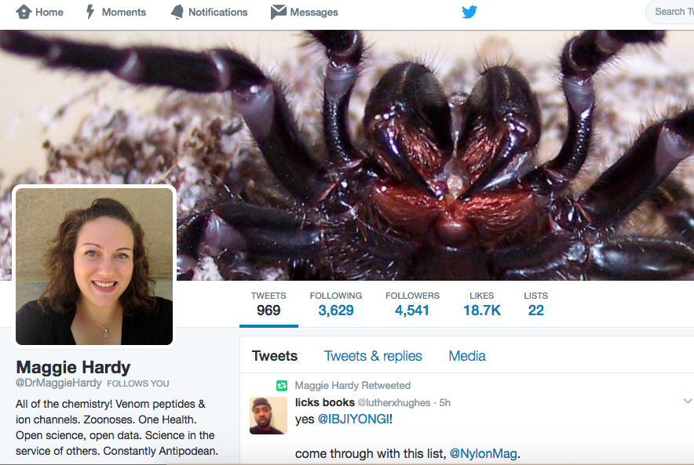
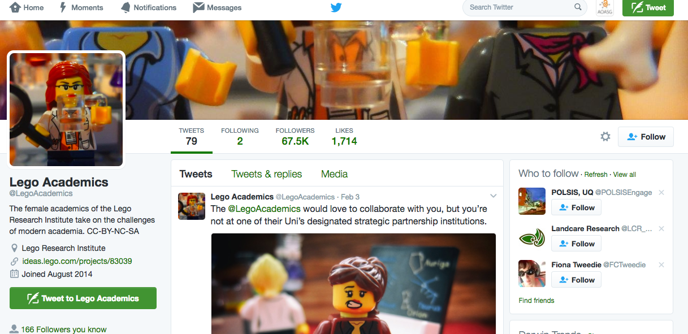
Twitter to promote you, your work and your interests

Slide 6

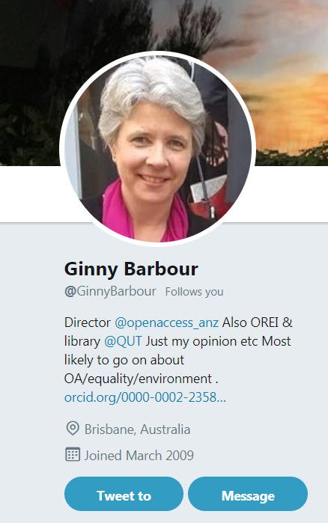

My rules of tweeting
Be yourself
- once you’ve decided who you are!
Stick to what you know (ish)
Tweets are professional communications
Be courteous
A tweet is forever

Slide 7
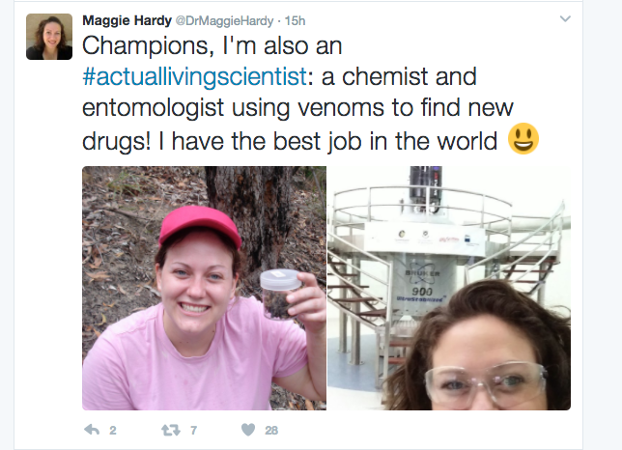
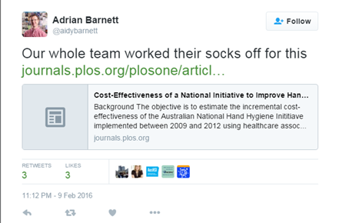
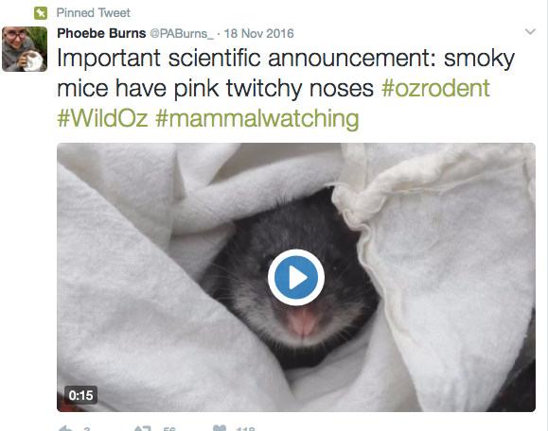
What makes a great tweet?
Timely
Engaging
On topic
….and the right length!

Slide 8
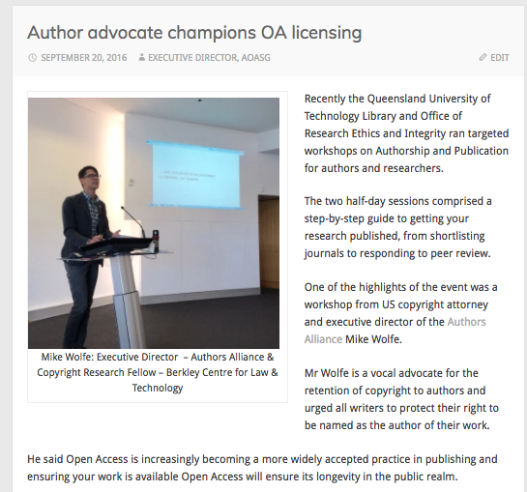
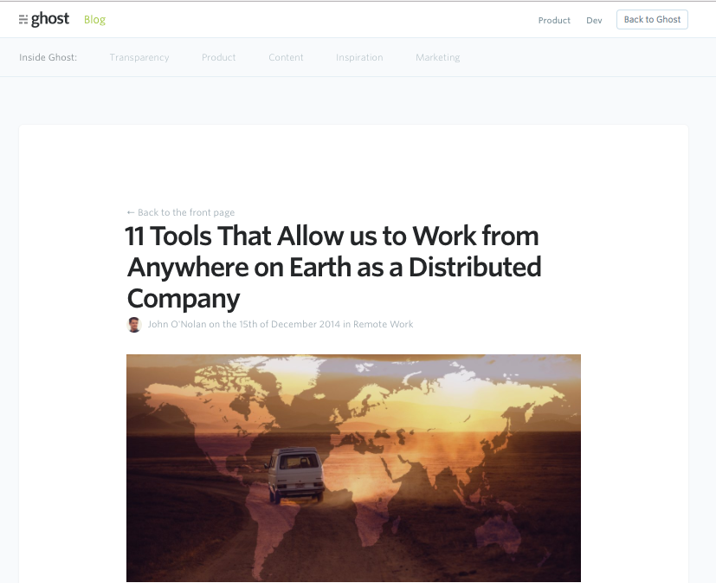
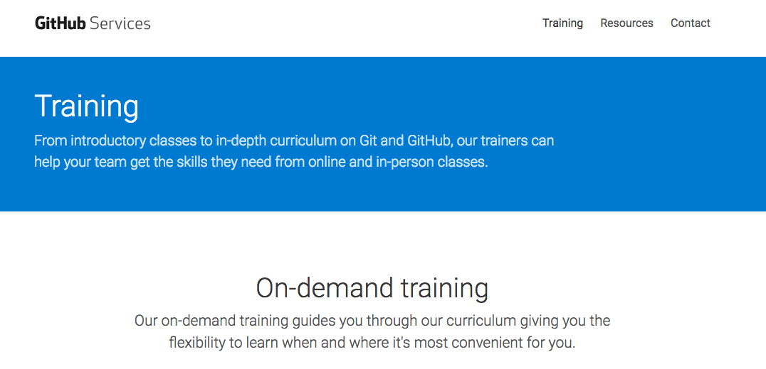

When a tweet isn’t enough
If you want to blog, you can build your own based on…
Wordpress
Ghost
Jekyll
Medium
Or many others

Slide 9
What makes a great tweet? blog
Timely
Engaging
On topic
….and the right length!

Slide 10
My rules of tweeting blogging
Be yourself
- once you’ve decided who you are!
Stick to what you know (ish)
Blogs are professional communications
Be courteous
And write for the 14 year old in your life!

Slide 11
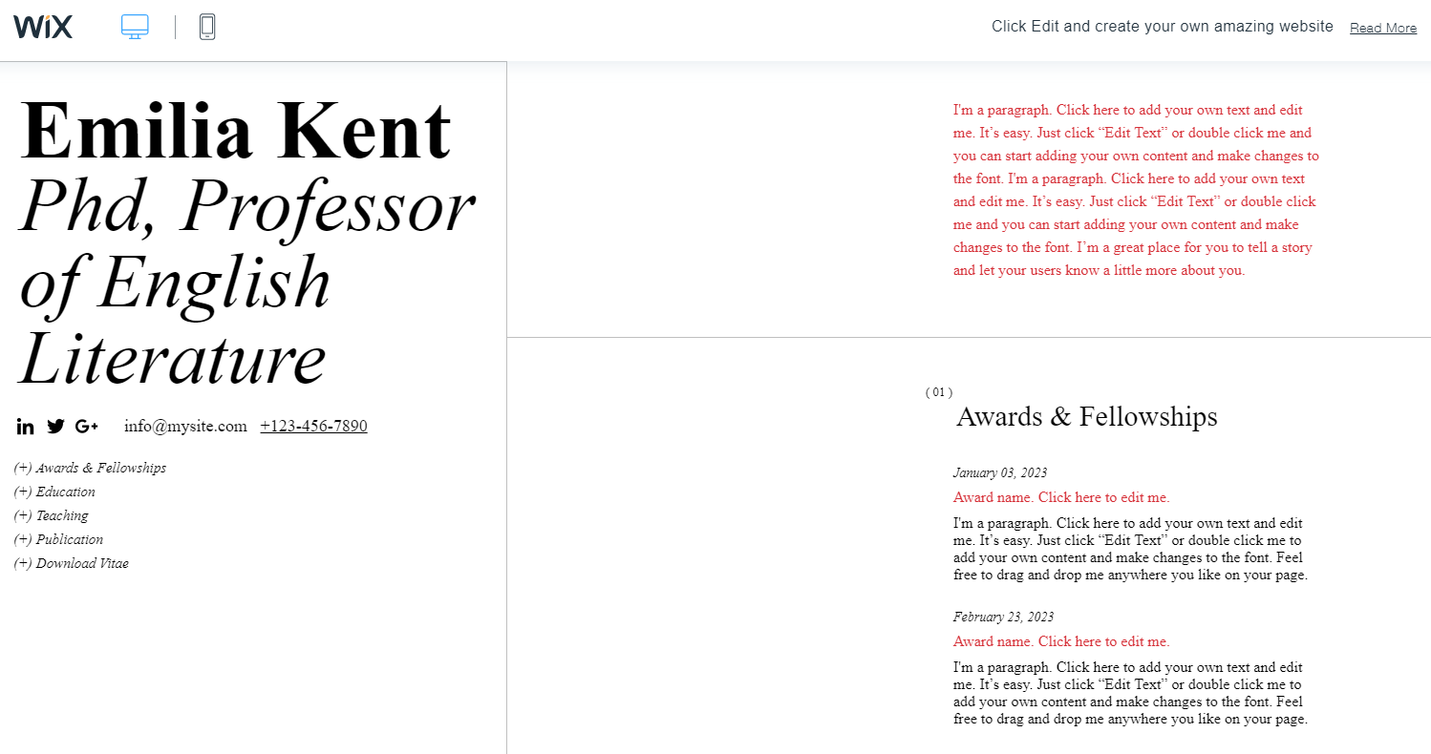
Websites for CVs
For CVs

Slide 12
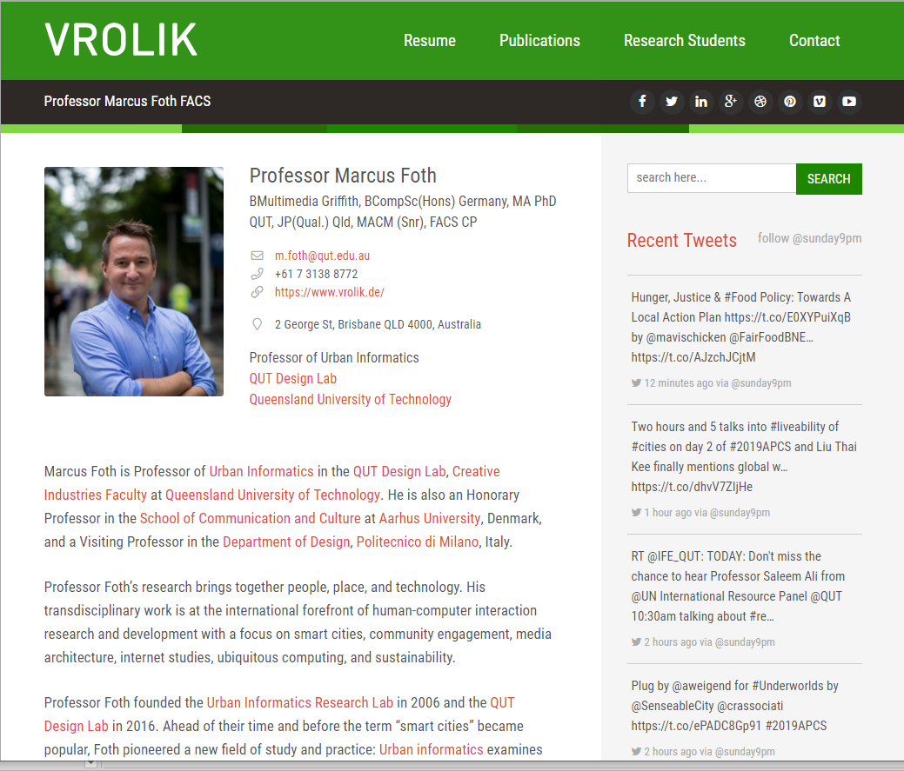
For professional profiles

Slide 13
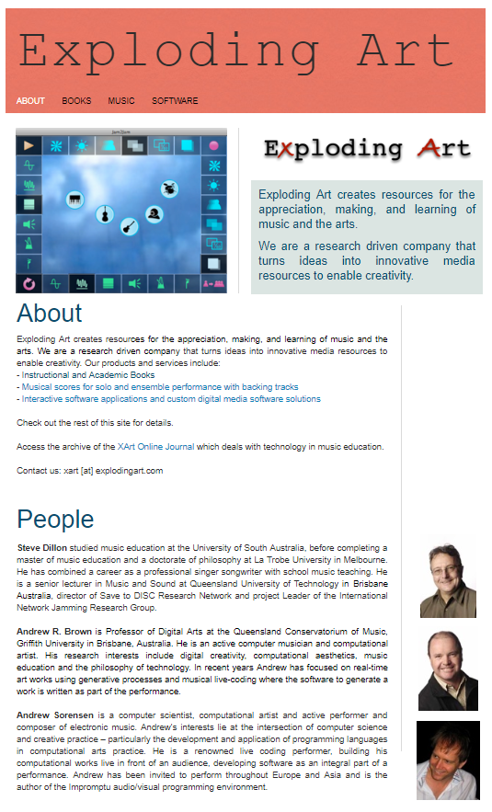
For spin-offs

Slide 14

Whichever site you use…
Keep it simple
Keep it up-to date
Keep it online (or hide it)

Slide 15
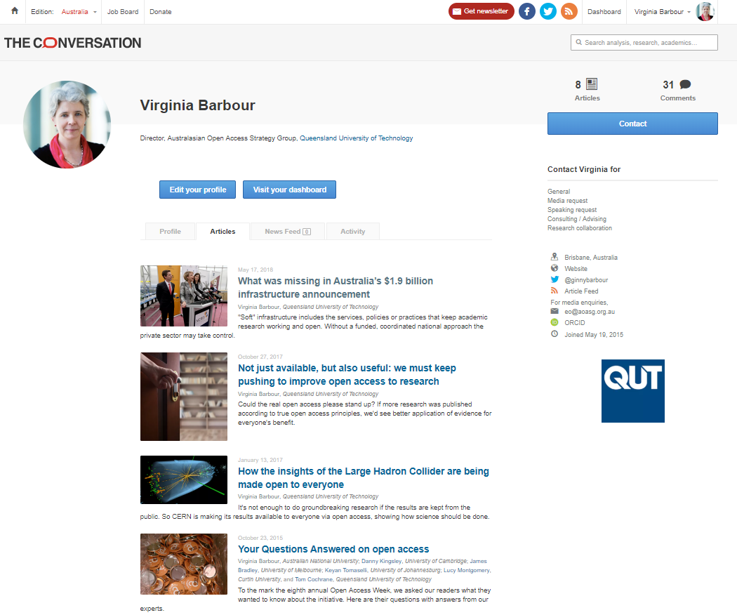
Don’t be afraid to pitch to general sites

Slide 16
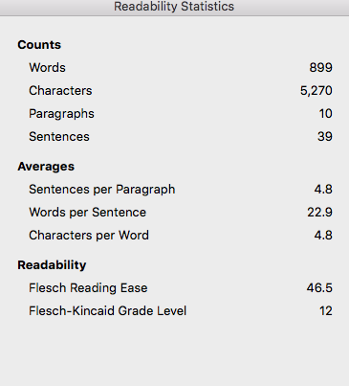
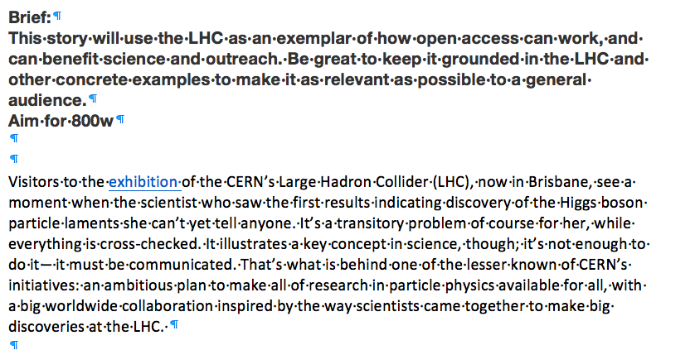
But ....stick to the brief!

Slide 17
Something else to consider - Wikipedia
Thesis
1-10
Median Wikipedia page
10,000 pa
Median Journal Paper
800
Top 5% Journal Paper
3,000
Top 5% Wikipedia page
1,000,000 pa
Slide from Thomas Shafee https://aoasg.org.au/webinar-series-2018/

Slide 18
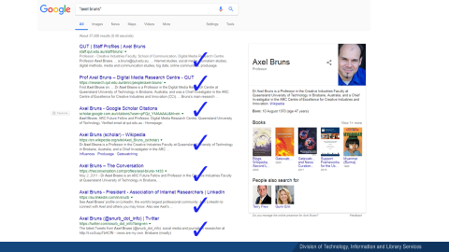
Finally – present your best online self
Google Yourself
Look at the first page of hits
What is you and what is not
Which ‘persona’ is being represented
What is inaccurate, out of date
What is missing
What should you ‘retire’
Slide from Jennifer Thomas Liaison Librarian, QUT
Notes:
Everyone in this room would have googled themselves at some point.
Sometime today, Google yourself and take a look at what comes up.
What shape is your digital persona in, and what it is saying about you as a QUT staff member?

